Slide 1

Basic Inorganic Chemistry For B.Tech & B.Sc I yr
Bio inorganic Chemistry
(3 lectures)
Role of transition metals such as Fe and Zn in biological systems, Cytochromes, Myoglobin, Hemoglobin, and Carbonic anhydrase
Prepared by Prof. Anil J. Elias, IIT Delhi

Slide 2
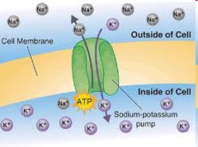
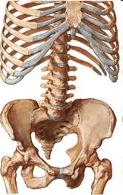
Bio Inorganic chemistry
Study of Inorganic elements in the living systems
Sodium potassium pump
(1/5th of all the ATP used)
Hemoglobin Vit B12 Hemocyanin Carbonic anhydrase
Myoglobin Carboxypeptidase
Cytochromes
Ferredoxin

Slide 3
Important roles metals play in biochemistry
1. Regulatory Action Sodium potassium channels and pump
Na, K Nerve signals and impulses, action potential muscle contraction
2. Structural Role Calcium in bones, teeth
Ca, Mg provide strength and rigidity
3. Electron transfer agents Cytochromes: redox intermediates
Fe²⁺/Fe³⁺ membrane-bound proteins that contain heme groups and carry out electron transport in Oxidative phosphorylation
4. Metalloenzymes Carbonic anhydrase, Carboxypeptidase
Zn biocatalysts, CO₂ to HCO₃⁻, protein digestion
5. Oxygen carriers and storage Hemoglobin, Myoglobin, Hemocyanin
Fe, Cu 18 times more energy from glucose in presence of O₂
6. Metallo coenzymes Vitamin B 12
Co biomethylation

Slide 4
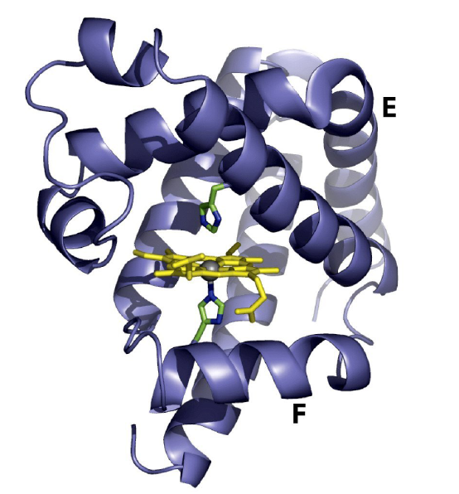
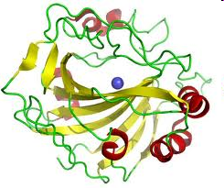
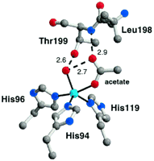
Structure of a metallo-protein : A metal complex perspective
Spiral - α helix form of protein Tape - β Pleated sheet form of protein
Prosthetic groups – A metal complex positioned in a crevice. Some of the ligands for this complex or some times all of the ligands are provided by the side groups of the amino acid units.
The geometry around the metal and bond distances and angles are decided by the protein unit
Myoglobin Carbonic anhydrase

Slide 5
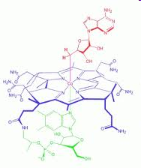
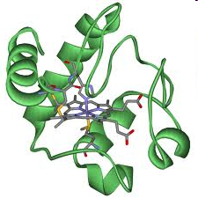
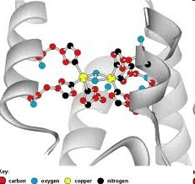
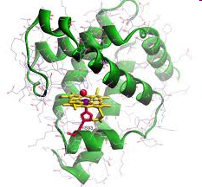
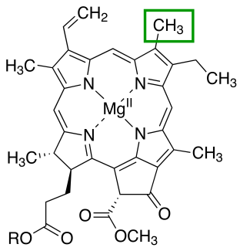
Metalloenzymes and Oxygen carriers = Protein + Cofactor
A cofactor is a non-protein chemical compound that is bound to a protein and is required for the protein's biological activity. These proteins are commonly enzymes. Cofactors are either organic or inorganic. They can also be classified depending on how tightly they bind to an enzyme, with loosely-bound or protein-free cofactors termed coenzymes and tightly-bound cofactors termed prosthetic groups.
Porphyrins with different metals at its centre are a common prosthetic group in bioinorganic chemistry
Cytochrome C
Coenzyme B12
Hemocyanin
Myoglobin
Chlorophyll

Slide 6
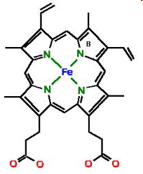
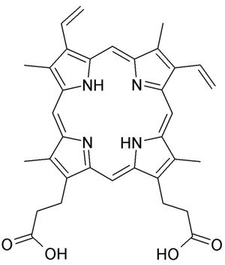
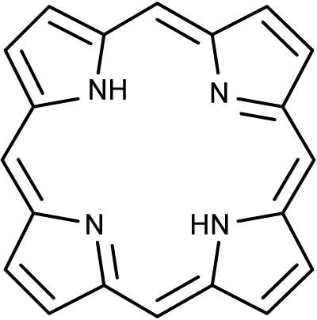
Protoporphyrin IX and Heme
15 different ways to arrange the substituents around the porphyrin. Only one isomer protopophyrin IX is found in the living system. Porphyrins are planar and aromatic

Slide 7
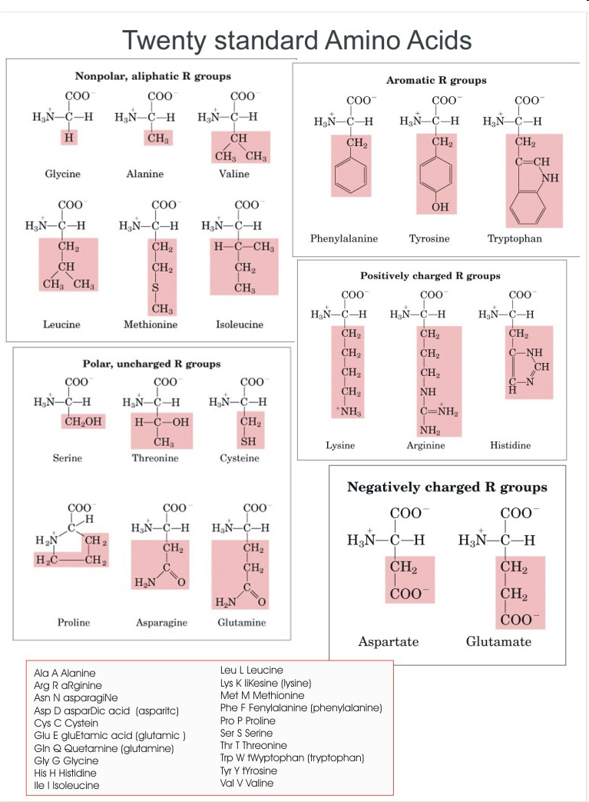
Proteins –consists of different amino acids in a specific sequence connected by the peptide bond –

Slide 8
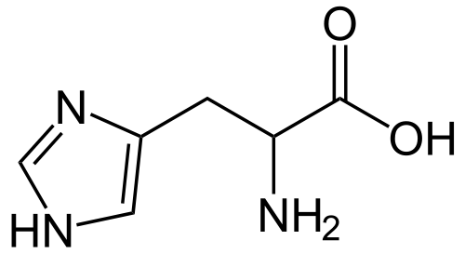
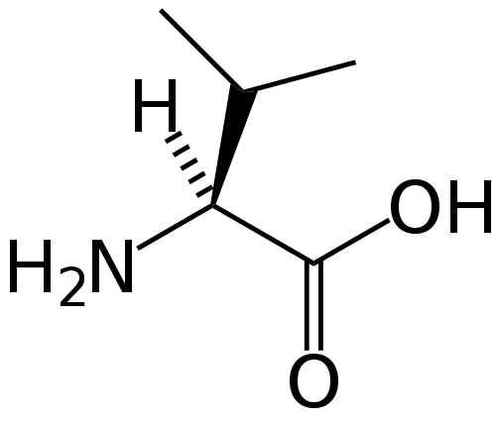
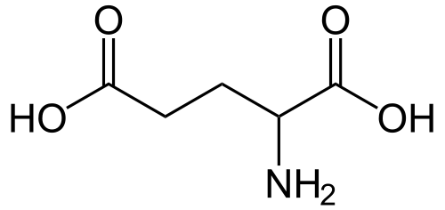
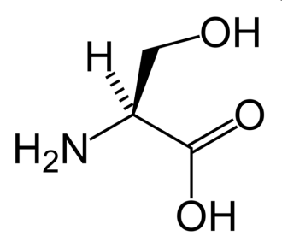
A few important amino acids relevant to the present course
HISTDINE This amino acid has a pKa of 6.5. This means that, at physiologically relevant pH values, relatively small shifts in pH will change its average charge. Below a pH of 6, the imidazole ring is mostly protonated.
VALINE is a branched-chain amino acid having a hydrophobic isopropyl R group. In sickle-cell disease, valine substitutes for the hydrophilic amino acid glutamic acid in hemoglobin.Valine is hydrophobic
GLUTAMIC ACID has carboxylic acid functional group which is hydrophilic, has pKa of 4.1 and exists in its negatively charged deprotonated carboxylate form at physiological pH ranging from 7.35 to 7.45.
SERINE Serine is an amino acid having a CH₂OH side group. By virtue of the hydroxyl group, serine is classified as a polar amino acid. Serine was first obtained from silk protein, a particularly rich source, in 1865.

Slide 9
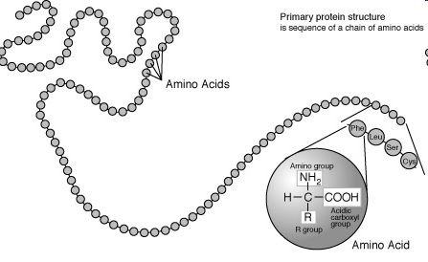
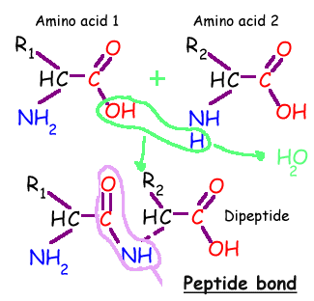
The primary structure of a protein

Slide 10
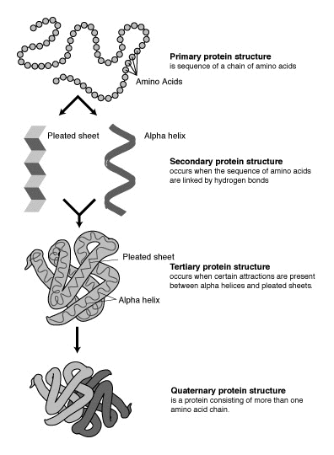
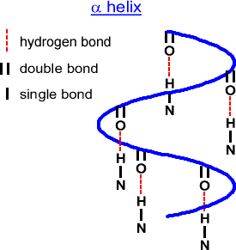
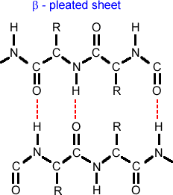
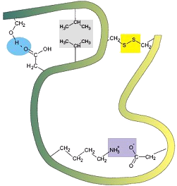
The four levels of protein structure
H bond between side chains, hydrophobic interactions, disulfur linkages, electrostatic interactions
See youtube video “protein structure” Univ of Surrey ’

Slide 11
Hemoglobin- a quaternary structure of a protein
4 units
Each unit has a prosthetic group (heme) embedded in a crevice and partly coordinated by histidine units

Slide 12
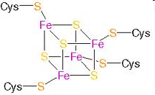
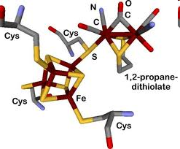
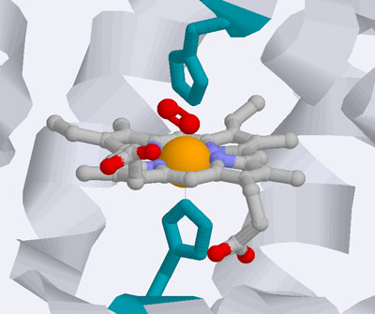
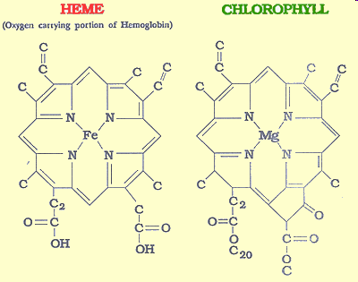
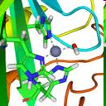
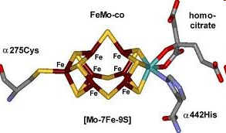
Inorganic Active site / Prosthetic group
In molecular biology the active site (prosthetic group) is part of an enzyme where substrates bind and undergo a chemical reaction. It can perform its function only when it is associated with the protein unit
Ferredoxin (e transfer)
Heme in Myoglobin (O₂ storage)
Carbonic anhydrase Enzyme)
Nitrogen Fixation

Slide 13
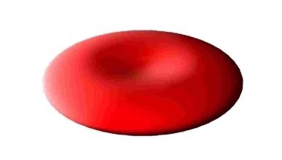
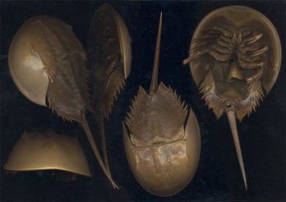
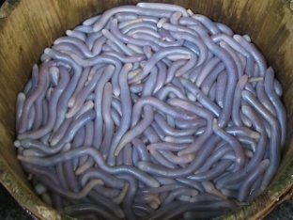
Inorganic Prosthetic group of three well known oxygen carriers
Present in Vertebrates
Present in molluscs
Present in some sea worms

Slide 14
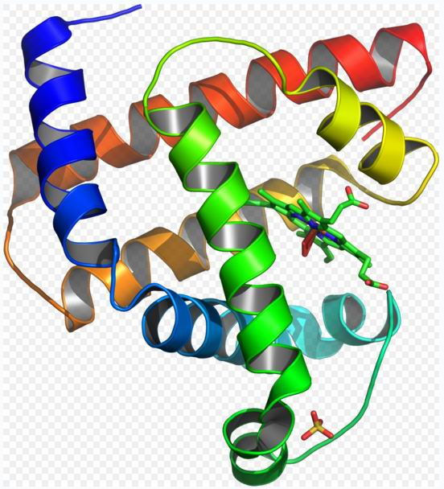
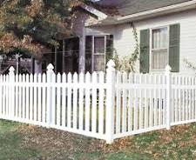
Can the prosthetic unit part of a metalloprotein perform its normal function without the protein unit around it ?
Reversible binding of O₂ is possible on when protein unit is present around the heme unit

Slide 15
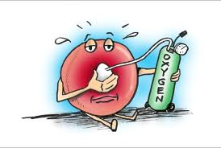
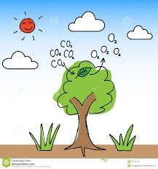
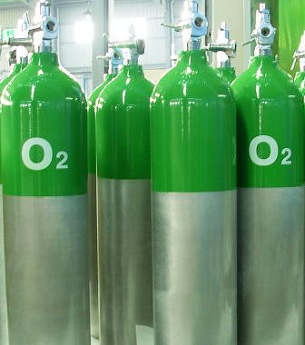
Oxygen : A few Questions
Why do we need oxygen or why do we breathe?
What happens to oxygen in our body and where does it happen?
How exactly does oxygen change to water ?
What does this reaction produce and how?
How exactly is oxygen carried around and stored in the body?
How exactly is CO₂ removed from the body?

Slide 16
Electron transfer agents Cytochromes: redox intermediates
Fe²⁺/Fe³⁺ membrane-bound proteins that contain heme groups and carry out electron transport in Oxidative phosphorylation
Cytochromes are, in general, membrane-bound (i.e. inner mitochondrial membrane) heme proteins containing heme groups and are primarily responsible for the generation of ATP via electron transport.
They are found bound on the inner mitochondrial membrane either as monomeric proteins (e.g., cytochrome c) or as subunits of bigger enzymatic complexes that catalyze redox reactions. These heme proteins are classified on the basis of the position of their lowest energy absorption band in the reduced state, as cytochromes a (605 nm), b (~565 nm), and c (550 nm).

Slide 17
Electron transfer agents; e.g. Cytochrome C

Slide 18
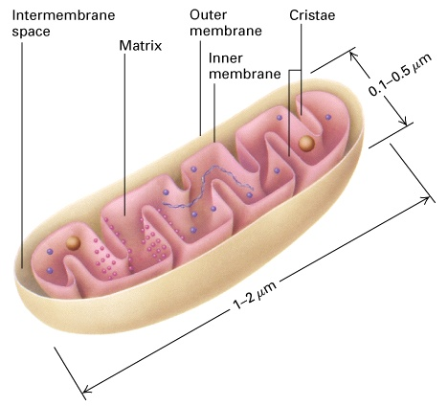
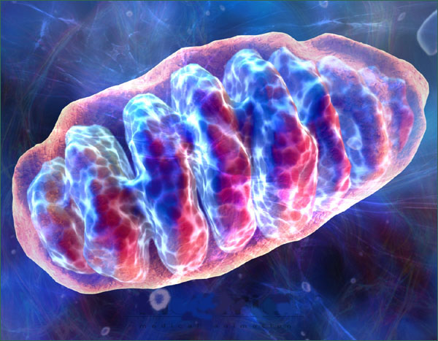
Mitochondria: The powerhouse of the Animal Cell
Bio-units of the electron transport chain are present on the inner walls of the mitochondrion.
Analogous powerhouses on the plant cells are chloroplasts

Slide 19
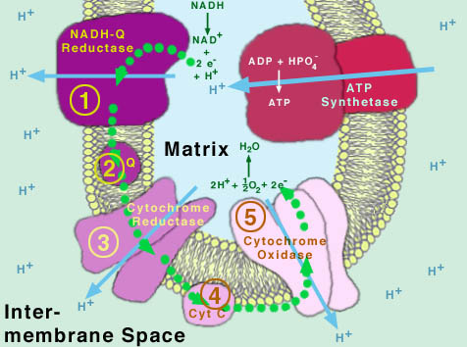
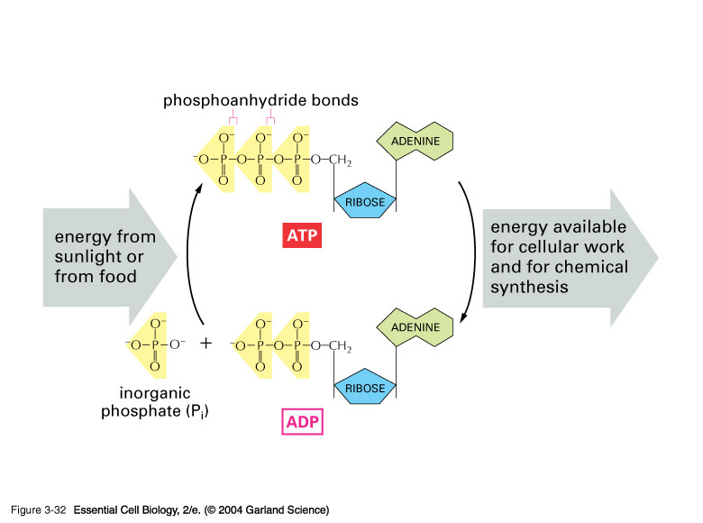
Glycolysis + Oxidative phosphorylation: How food is converted into energy
ATP : Universal currency for energy
in living systems
Different forms of Cytochromes (except Cytochrome P-450) are involved in the electron transfer process leading to ATP synthesis and conversion of O₂ to H₂O
See youtube video ‘cellular respiration ( electron transfer chain)’

Slide 20
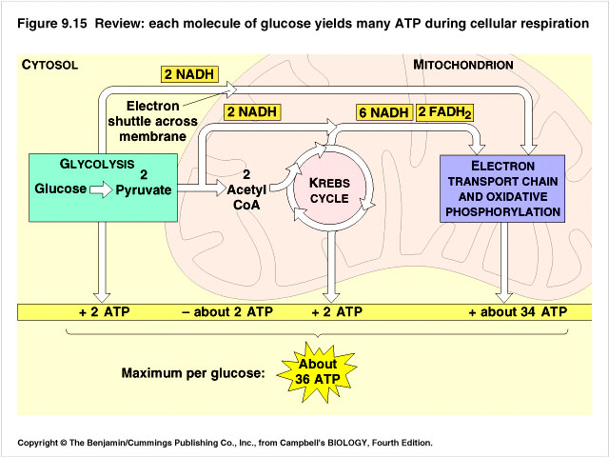
See youtube video ‘gotta get that ATP’ for fun and learning!

Slide 21
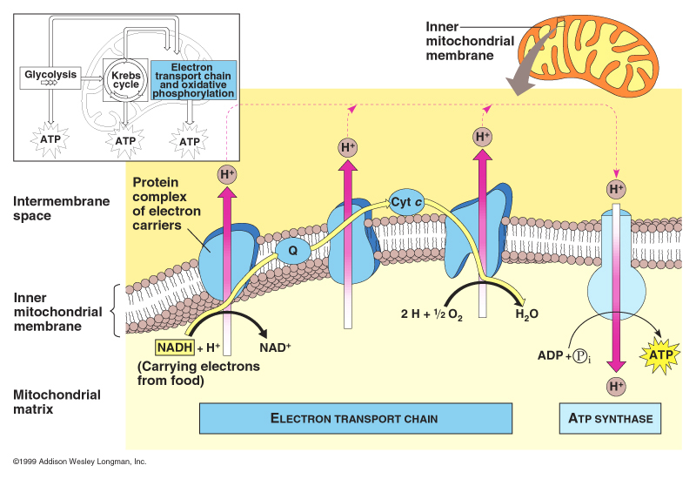

Slide 22
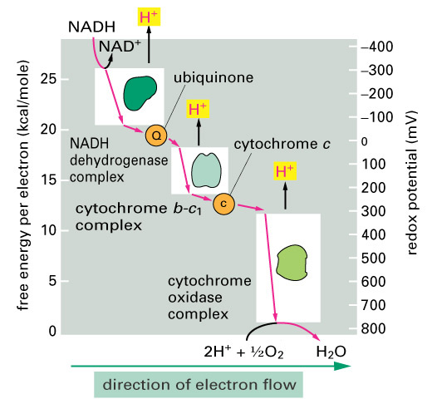
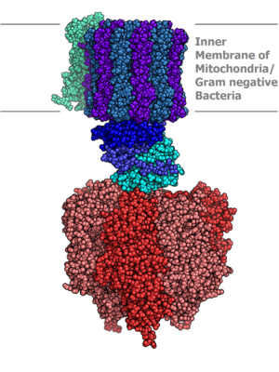
Actual structure of ATP synthase unit (a molecular machine!)
Cytochromes a and a₃ | Cytochrome c oxidase with electrons delivered to complex by soluble cytochrome c (hence the name)
Cytochromes b and c₁ | Cytochrome c reductase

Slide 23
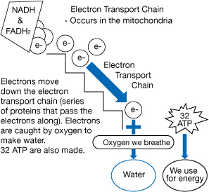
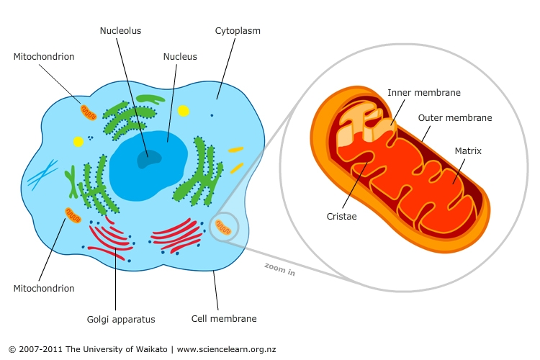
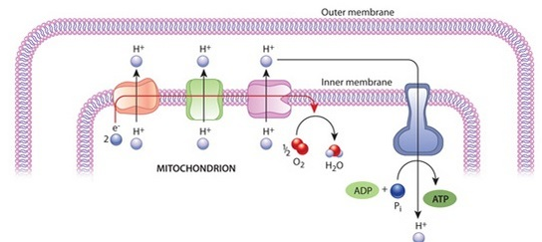

Slide 24
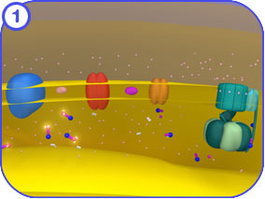
Why do we need oxygen or why do we breathe?
Oxygen is required for efficiently converting glucose to energy and generate ATP (Oxidative phosphorylation). In the presence of oxygen 18 times more energy is released from the oxidation of glucose
What happens to oxygen in our body and where does it happen?
Oxygen gets converted to water. It happens on the inner membrane of the mitochondrion exactly at the last stage of electron transport chain (on cytochorme c oxidase)
How exactly does oxygen change to water ?
Protons present inside the mitochondrion along with the electrons of the correct potential ( generated during oxidation of food and supplied through the electron transport chain) react with O₂ and convert it to water generating a proton gradient
What does this reaction result in?
The proton gradient generated during the electron transport chain and conversion of O₂ to water drives the molecular machine called ATP synthase which makes ATP from ADP and P_{i} (Inorganic phosphate). ATP is the universal currency of energy in living systems
How exactly is oxygen carried around and stored in the body?
Su…gar goes to ATP…. !
Youtube: ATP synthase molecular machines

Slide 25

Cytochromes in the electron transport chain
Cytochrome reductase (or b): Complex unit having 2 different hexacoordinated hemes and an Fe-S cluster
Function :electron transfer and proton gradient generation
Cytochrome c: Unit having one hexacoordinated heme
Function: electron transfer
Cytochrome c oxidase: Unit has pentacoordinated heme and tricoordinated Cu
Function: electron transfer to O₂ converting it to water
+ proton gradient generation
Ageing is related to generation of oxygen based free radicals which degrade mitochondrial membranes

Slide 26
Redox intermediates in electron transfer
Cytochrome C
Protein chain has 103 amino acid units in some fish, 104 units in terrestrial vertebrates and 112 in plants
The most structurally well understood cytochrome. The heme active site is hexa coordinated with N from a histidine residue and S from a methionine residue. Present in photosynthesis and respiration chains- one of the oldest chemicals present in biological processes

Slide 27


Active site of Cytochrome c oxidase
The last enzyme in the respiratory electron transport chain and is located in the mitochondrial membrane. It receives an electron from each of four cytochrome c molecules, and transfers them to one oxygen molecule, converting molecular oxygen to two molecules of water.
The Fe is pentacoordinated and binds O₂ (along with the Cu) before reducing it.
This is also the site which CN⁻ binds during cyanide poisoning [stabilizing the Fe³⁺ state and preventing its redox (Fe²⁺/ Fe³⁺) activity] (Cyanide is a very strong ligand)
Youtube video: A metabolic poison How cyanide disrupts ATP synthesis
Cyanide
Summary reaction:
4 Fe ²⁺cytochrome + 8 H⁺_{in} + O₂ → 4 Fe ³⁺cytochrome + 2 H₂O + 4 H⁺_{out}

Slide 28

Metalloenzymes: Carbonic Anhydrase
A single polypeptide chain ( M = 29,000) complexed to one Zn²⁺ ion. The zinc prosthetic group in the enzyme is coordinated in three positions by histidine side-chains. The fourth coordination position is occupied by water. This causes polarisation of the hydrogen-oxygen bond, making the oxygen slightly more negative, thereby weakening the bond. A fourth histidine is placed close to the substrate of water and accepts a proton. This leaves a hydroxide attached to the zinc. The reaction catalyzed by carbonic anhydrase is given below which occurs 5000 times faster in presence of the enzyme:
in tissues- high CO₂ concentration)
Carbonic anhydrase has one of the highest overall rates of reactions of any enzymes. This is expressed in terms of turnover number of a catalyst (number of substrate molecules converted per molecule of the enzyme per second; same as TOF in organometallic catalysis). For human carbonic anhydrase it is 400,000 to 600,000 per second.
Most efficient catalytic reaction known so far !!
Reaction increases acidity in the tissues

Slide 29




Metalloenzymes: Carbonic Anhydrase
Why Zinc?
A good Lewis Acid
Only one stable oxidation state
Complexes are labile than other divalent metals
Favors tetrahedral geometry

Slide 30

The active site also contains specificity pocket for carbon dioxide, bringing it close to the hydroxide group. This allows the electron rich hydroxide to attack the carbon dioxide, forming bicarbonate
Carbonic anhydrase increases acidity in the vicinity..With enough carbonic anhydrase enzymes present, therefore, carbon dioxide can cause a decrease in the pH of the solution due to all the protons produced from its reaction with water.
Watch Youtube video carboanhydrase

Slide 31


Dioxygen storage in the tissues: Myoglobin
Proximal histidine
Eight α helixes (~75%),
M. Wt. ~17,000
153 amino acid units Single heme unit pentacoordinated (deoxy)
Distal histidine

Slide 32
Changes at the active site during oxygenation of Myoglobin
Role of distal histidine: Makes O₂ to bind in a bent fashion and makes it difficult for CO to bind in a linear fashion.
An isolated heme binds CO 25000 times as strongly as O₂ in solution. In the living system binding affinity for oxygen is reduced considerably. For CO to bind strongly, it has to bind linearly which is made difficult by distal histidine

Slide 33
Oxymyoglobin and oxyhemoglobin: Evidence for Fe³⁺ O₂−
ν _{O-O} of oxyhemoglobin, 1107 cm⁻¹
is closer to the
ν _{O-O} O₂⁻ value of 1145 cm⁻¹ than
ν _{O-O} O₂ value of 1550 cm⁻¹
This difference suggests the formation of O₂⁻ which is a spin ½ ion in combination with low spin Fe³⁺ which is also spin ½ and these two spins can pair by what is well known as antiferromagnetic coupling and will be diamagnetic

Slide 34


Red Blood Cells –Fact sheet
1 microlitre of blood (1/50th of an average drop) of an adult human has
RBC 4,000,000 - 6,000,000
WBC 4,000–11,000
Platelets 150,000–400,000
Each human red blood cell (RBC) contains approximately 270 million of hemoglobin molecules, each carrying four heme groups;
Hemoglobin comprises about a third of the total RBC volume. The red blood cells of an average adult human male store collectively about 2.5 grams of iron.
The cells develop in the bone marrow (stem cells) and circulate for about 100–120 days in the body before their components are recycled. Each circulation takes about 20 seconds. Approximately 1/4th of the cells in the human body are red blood cells
Mammalian red blood cells are unique among the vertebrates as they don’t have a cell nucleus in their mature form (so no chromosomes or DNA present). These cells have nuclei in the early stages of development, but extrude them as they mature in order to provide more space for hemoglobin. These cells also does not have cellular organelles such as their mitochondria.

Slide 35


RBC strange shape -- a biconcave disc that is round and flat
RBC has no nucleus. The nucleus is extruded from the cell as it matures.
An RBC can change shape to an amazing extent, without breaking, as it squeezes single file through the capillaries.
An RBC contains hemoglobin.
270,000,000 hemoglobin units are present per RBC. Each hemoglobin has 4 heme units; 2 α and 2 β units. Active site of a heme unit has an Iron ion

Slide 36



Hemoglobin Hb
Hb is not an exact tetramer of Mb
Four units of Hb
3 major types of Hb
Hb A (Adult)
Hb F ( Fetal)
Hb S (Sickle cell)
See youtube video ‘Oxygen Transport’

Slide 37
Basics of oxygenation remains same for Hb and Mb. But there are some differences in the way the four units get oxygenated. This begins with pulling of the proximal histidine when Fe gets inside the plane of the porphyrin ring upon oxygen binding

Slide 38




Hemoglobin: Tense (T) and Relaxed (R) States; Deoxy versus Oxy: The cooperative effect
Binding of O₂ to Hb is cooperative. The presence of bound oxygen favor addition of more O_{2.} The Hb molecule goes from a tense to a relaxed state. Pockets of heme gets more easy for the following O₂ units to access due to breaking of some weak interactions.
This happens like chain and pulley. The pulling of the proximal histidine along with the activity of Fe getting into the plane of the porphyrin triggers this activity
Removing the first stamp requires more effort
Deoxy Hb Oxy Hb

Slide 39



Hemoglobin; An allosteric protein
An allosteric protein does not have fixed properties. Its functional characteristics of are regulated by specific molecule present in its environment. Hemoglobin is an allosteric protein while Myoglobin is not.
Function of Hemoglobin in the living system is regulated by oxygen partial pressure, H+ concentration and 2, 3 biphosphoglycerate presence (BPG)
O₂
Bohr Effect (effect of H+ on Hb)
2,3-BPG (saturation of O2 on Hb-F)

Slide 40
The Bohr Effect
Christian Bohr, father of Niels Bohr discovered this effect. An increase in concentration of protons and/or carbon dioxide will reduce the oxygen affinity of hemoglobin
The chemical basis for the Bohr effect is due to the formation of two salt bridges of the quaternary structure. One of the salt bridges is formed by the interaction between Histidine 146 and Lysine 40. This connection will help to orient the histidine residue to also interact in another salt bridge formation with the negatively charged aspartate 94. The second bridge is formed with the aid of an additional proton on the histidine residue.
Below a pH of 6, the imidazole ring of histidine is mostly protonated thus favoring salt bridge formation
A salt bridge ( weak electrostatic interaction)

Slide 41


2, 3 biphospho glycerate (BPG)
2,3- Biphosphoglycerate
The organic compound 2, 3 biphospho glycerate (BPG) binds to hemoglobin A and reduces its O₂ affinity by a factor of 26. This at the first instance will make one wonder why? Interestingly, this increases the oxygen-binding affinity of fetal hemoglobin (Hb-F) relative to that of maternal (Hb-A) hemoglobin. This difference in oxygen affinity allows oxygen to be effectively transferred from maternal to fetal red cells, the transport of oxygen from mother to fetus.

Slide 42



Hemoglobin A and Hemoglobin F Differences
Babies are born with hemoglobin F (Fetal), but after a few months, the body shuts off its synthesis and starts making hemoglobin A (Adult). That's called the hemoglobin switch.
From the structural point of view, the adult hemoglobin is composed of 4 heme groups, 2 alpha chains and 2 beta chains. The fetal hemoglobin is also composed of 4 heme groups, 2 alpha chains and 2 delta chains. The δ chain is 72% identical in amino acid sequence with the β chain. One noteworthy change is the substitution of a serine residue for Histidine143 in the β chain. In addition, the fetal hemoglobin and adult hemoglobin are found to be different near the 2,3 BPG binding site. The 2,3 BPG binds less tightly with the deoxy form of fetal hemoglobin as compared to the deoxy form of adult hemoglobin.
Hb A β chain
Histidine
Hb F δ chain Serine

Slide 43





Hemoglobin S (Sickle Cell Anaemia)
Sickle-cell anaemia is caused by a mutation in the β-globin chain of haemoglobin, causing a hydrophilic amino acid glutamic acid to be replaced with the hydrophobic amino acid valine.
In areas where malaria is a problem, people's chances of survival actually increase if they carry sickle-cell trait (Carrier). The malaria parasite has a complex life cycle and spends part of it in red blood cells. In a carrier, the presence of the malaria parasite causes the red blood cells with defective haemoglobin to rupture prematurely, making the plasmodium unable to reproduce. The polymerization of Hb S affects the ability of the parasite to digest Hb.
See youtube videos ‘Sickle Cell’ and ‘Sickle cell disease’

Slide 44

RBC with Deoxy Hb-S changes its disc shape to a sickle shape. The valine unit make the Hb-S units to stick together (polymerise) forming strands and change the shape of RBC
Glutamic acid hydrophilic
Valine
hydrophobic
HbA (Adult) normal
HbS (Sickle Cell)

